Slide 1
Unit 4
Medi caps university

Slide 2
dEATH
Death is not an event it is a process
The study of death and dying from a variety of reasons including medical, physical, psychological, spiritual, ethical, and more, is known as Thanatology.
Taphonomy is the study of post-mortem changes.

Slide 3
Types of Death
1. Somatic death or Clinical death
In this there is complete and irreversible stoppage of any of Bishop’s tripod of life components which includes
Heart – circulation
Lung – respiration
Brain function
Or there is a loss of any one function and it leads to death or the Doctor declares the individual dead

Slide 4
2. Molecular death or Cellular death
It Occurs within 1-2 hours after somatic death
Bichat’s mode of death
It Depends on the dysfunction i.e., may be respiratory, circulatory, or brain function.
Dysfunction of respiration leads to Asphyxia
Dysfunction of circulation leads to Syncope
Dysfunction of brain function leads to Coma
Asphyxia, syncope, and coma are examples of Bichat’s mode of death.

Slide 5
Atria mortis or Gateway of death
Stopping of only one component of Bichat’s tripod of life (respiration, circulation, or brain function) results in death. It is an example of somatic death.
Suspended Animation or Apparent death
In this, signs of life are reduced to a minimal level and resuscitation leads to survival. The causes of suspended animation can be Prolonged anesthesia, Newborn (most common), barbiturate poisoning, Cholera, Cachexia, Concussion, Drowning, Electrocution, Hypothermia, Hyperthermia, Sunstroke, Shock, Insanity, Trance (voluntarily suspended animation seen in yoga practitioners), Typhoid (enteric fever) and Morphine overdose.

Slide 6
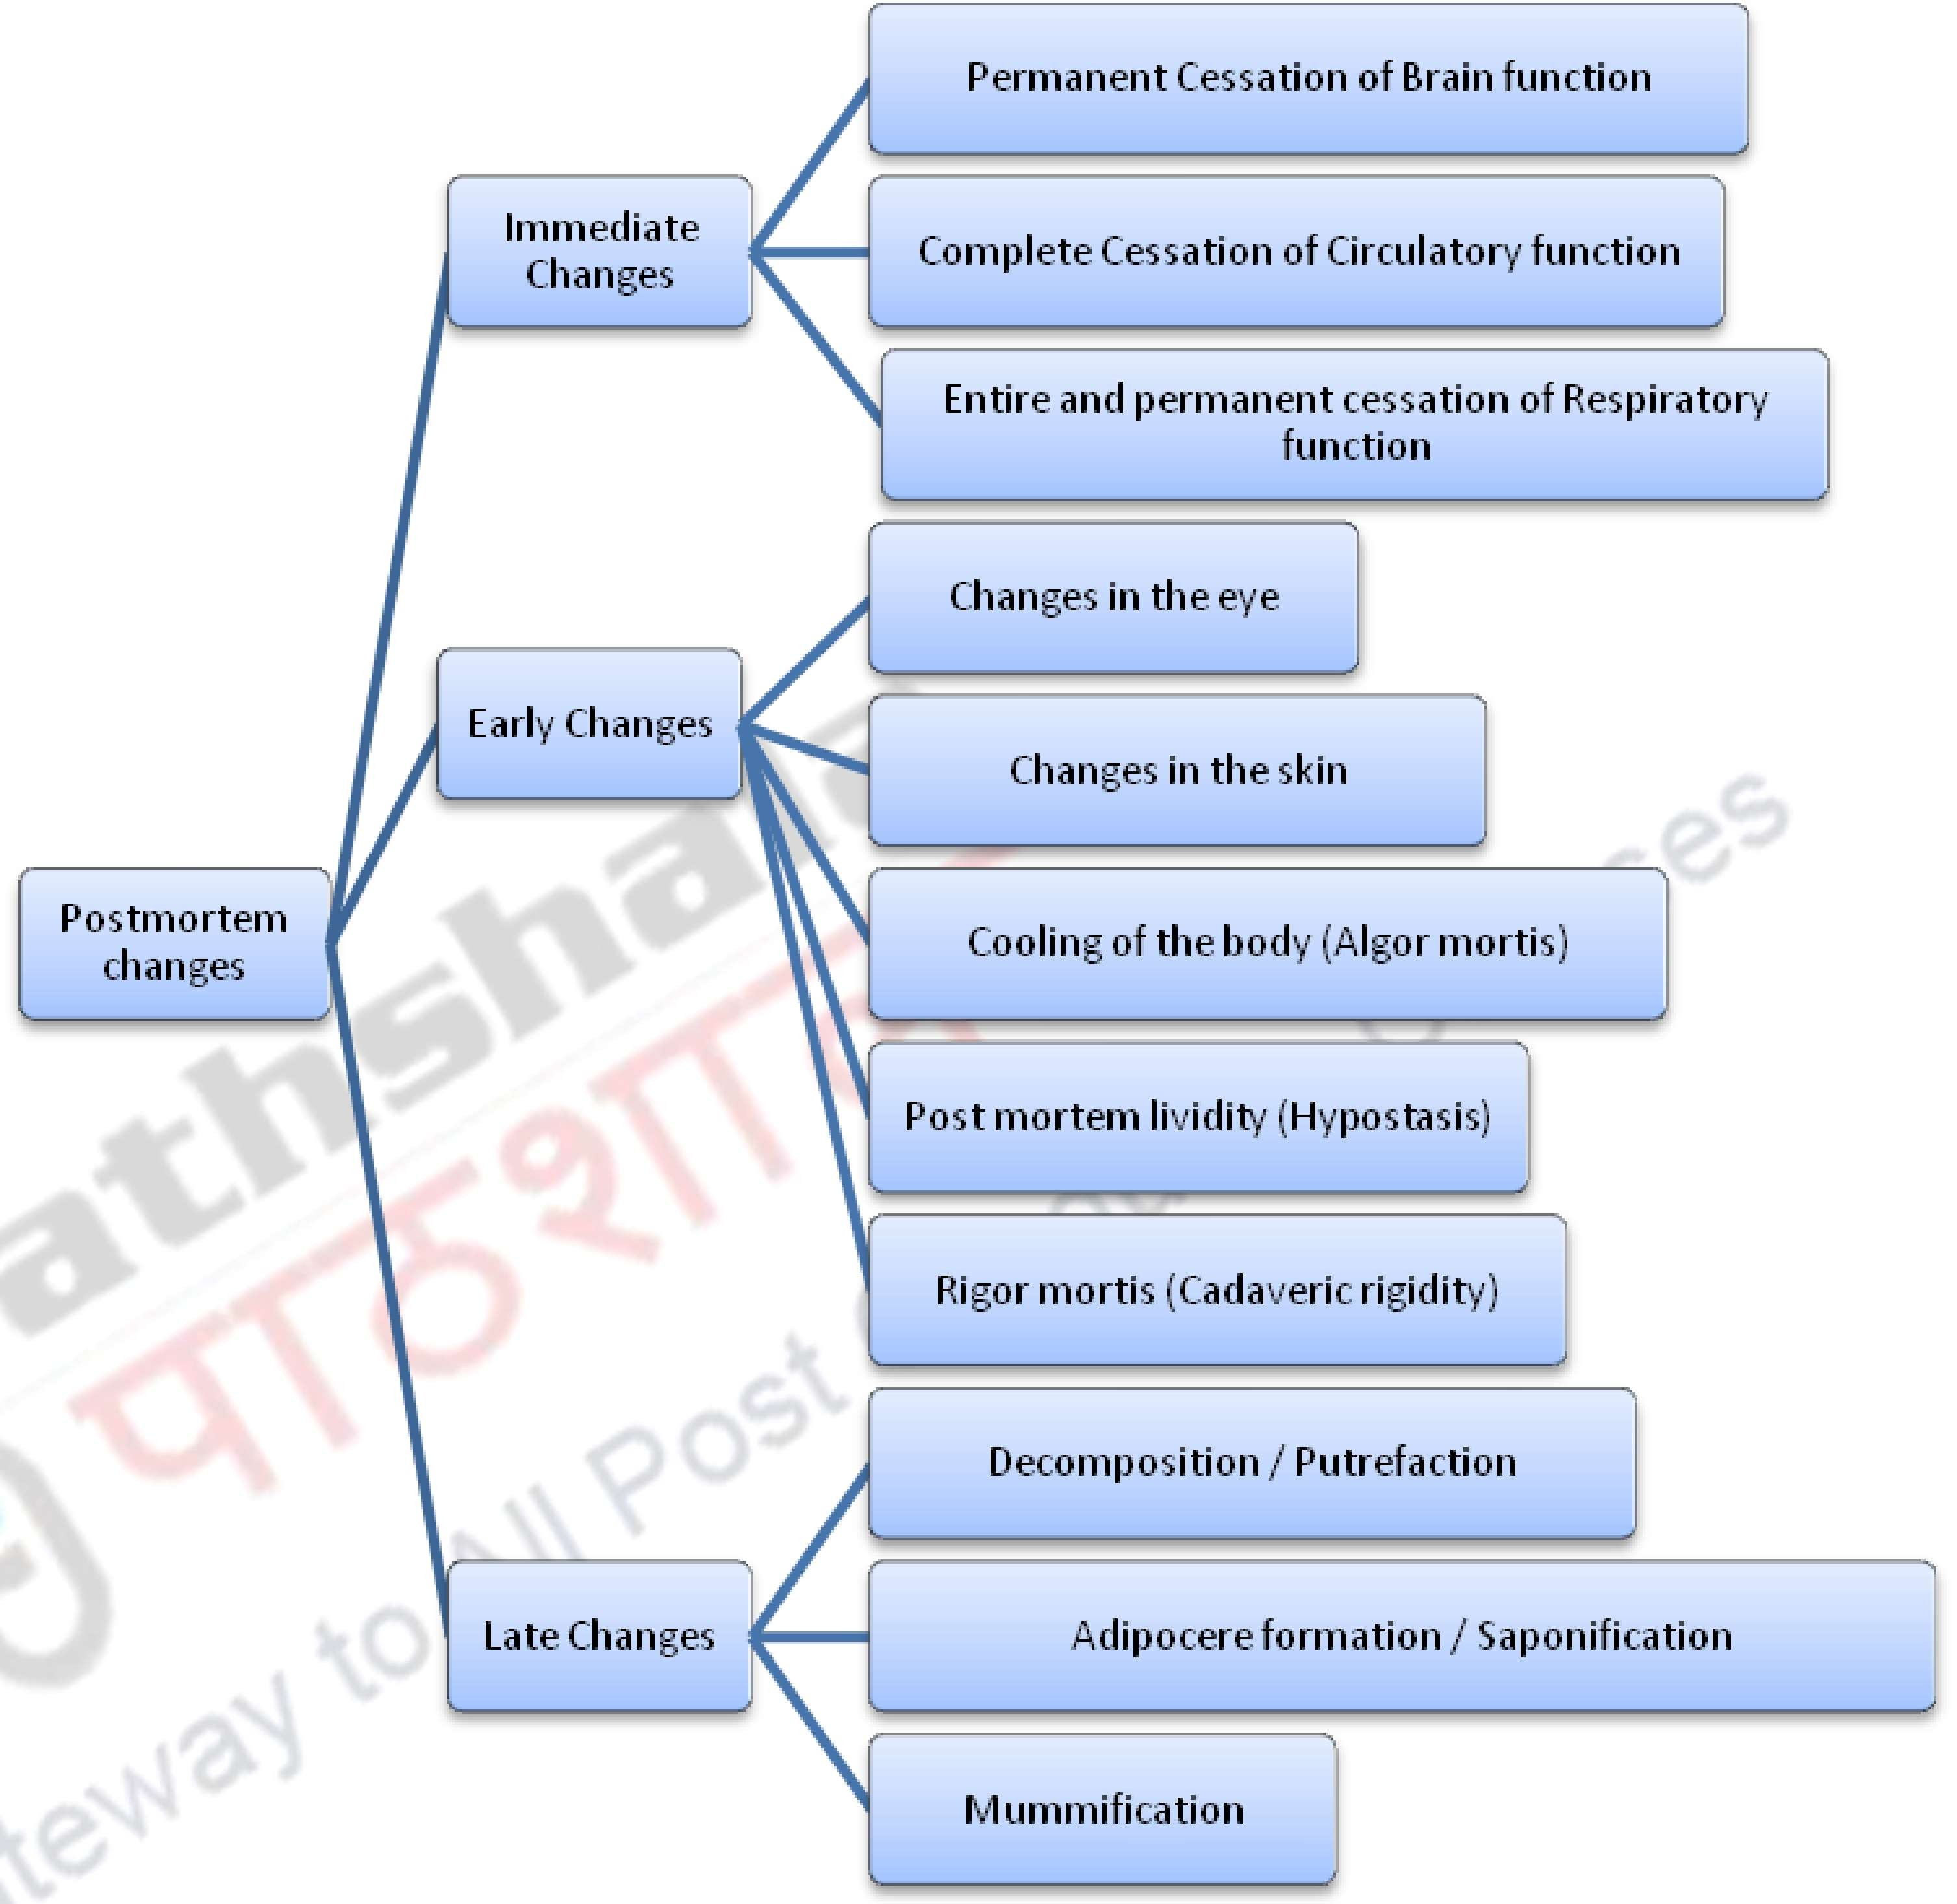


Slide 7
Decomposition/ Putrefaction
It is Last stage in the resolution of the body where complex organic body constituents get converted to the simple inorganic state. Putrefaction is mainly brought about by two processes: Autolysis and bacterial action.
Autolysis:
This is rise in level of enzyme in tissues after death.
They soften and liquefy the dead tissues as the part of digestive action of the enzyme.
The earliest autolytic changes can be seen in parenchymatous tissues or soft tissues.
Autolysis Starts 3-4 hours after death and continues for 2-3 days, sometimes even longer.
The process can be stopped by freezing.

Slide 8
Bacterial action:
Action of bacterial enzymes (aerobic and anaerobic) on tissue components like carbohydrates/fat/proteins.
For bacterial growth – warmth, moisture are conditions favorable conditions.
Clostridium, streptococci, E coli, Bacillus proteus are the bacteria known to decompose body tissue components.
Clostridium welchii is the bacteria which initiates haemolysis of blood and starts the process of putrefaction.
In warm climate putrefaction starts comparatively faster while in cold climate the process is retarded.
Development of gases under the skin and hollow viscera takes 18-36 hrs.
24-48 hrs in case of solid viscera.

Slide 9
Purefaction changes include:
Change in colour: discolouration varies from green to black due to formation of sulphmethaemoglobin.
Foul smelling gases: Hydrogen sulphide ammonia phosphorated hydrogen and methane are the gases and its formation creates foul smell.
Sufficient accumulation of these gases is the reason why body floats in case of drowning

Slide 10
Factors affecting putrefaction:
Warmth and clothing
Moisture
Air
Age
Manner of burial
Condition of body
Sex
Mode of death

Slide 11
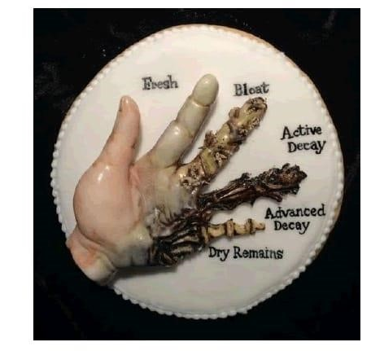

Slide 12
Stages of Decomposition
The decomposition of a body typically goes through seven stages, often used in forensic science and anthropology to understand the process.
Fresh Stage: Immediately after death, the body starts to cool (algor mortis) and undergoes changes in coloration. Rigor mortis (stiffening of muscles) begins within a few hours. The fresh phase can start as early as 24 hours and as late as 7 days after death, especially in colder winter months.
Bloat Stage: Within a few days, gases produced by bacteria cause the body to swell. Discoloration occurs, and fluids may begin to leak from orifices.
Active Decay Stage: The body breaks down significantly as maggots and bacteria consume tissues. The skin may rupture, and there’s a noticeable odor due to the release of gases and decay products.

Slide 13
Advanced Decay Stage: Tissues continue to decompose, and most of the soft tissue is gone. The body may appear skeletal, with less odor as the remaining materials decompose.
Dry Remains Stage: The body is mostly skeletonized, with some dried tissues remaining. Environmental factors influence the rate of decomposition at this stage.
Skeletonization Stage: The remains are primarily bones, possibly with some mummified tissue. The bones may start to show signs of weathering.
Decomposition Complete: Eventually, the bones may break down and be subject to environmental factors, leading to their eventual disintegration or mineralization.
These stages can vary significantly depending on environmental conditions, such as temperature, humidity, and the presence of scavengers.

Slide 14
Human Body Decomposition Timeline
24-72 hours after death — the internal organs decompose.
3-5 days after death — the body starts to bloat and blood-containing foam leaks from the mouth and nose.
8-10 days after death — the body turns from green to red as the blood decomposes and the organs in the abdomen accumulate gas.
Several weeks after death — nails and teeth fall out.
1 month after death — the body starts to liquify.

Slide 15
Role of insect in Decomposition
Insects play a crucial role in the decomposition process, aiding in the breakdown of organic matter and recycling nutrients back into the ecosystem.
Initial Colonizers: After death, insects, particularly blowflies, are often among the first to arrive. They are attracted to the body by the odor and lay their eggs in exposed areas.
Feeding and Breakdown: Larvae (maggots) hatch from the eggs and begin feeding on the decaying tissue. This feeding accelerates decomposition by breaking down tissues into smaller components.

Slide 16
3. Nutrient Recycling: As insects consume decomposing material, they facilitate the recycling of nutrients. Their waste products enrich the soil, promoting plant growth.
4. Predators and Scavengers: Other insects, such as beetles, may feed on the larvae or on remaining tissues, further aiding in decomposition. Their activities help control the population of other decomposers.
5. Indicator Species: Certain insects can indicate the time since death, aiding forensic investigations. The presence of specific insect species can provide crucial information about the environment and time frame of decomposition.
6. Microbial Facilitation: Insects also help disperse bacteria and fungi that contribute to the decomposition process, enhancing microbial activity.

Slide 17
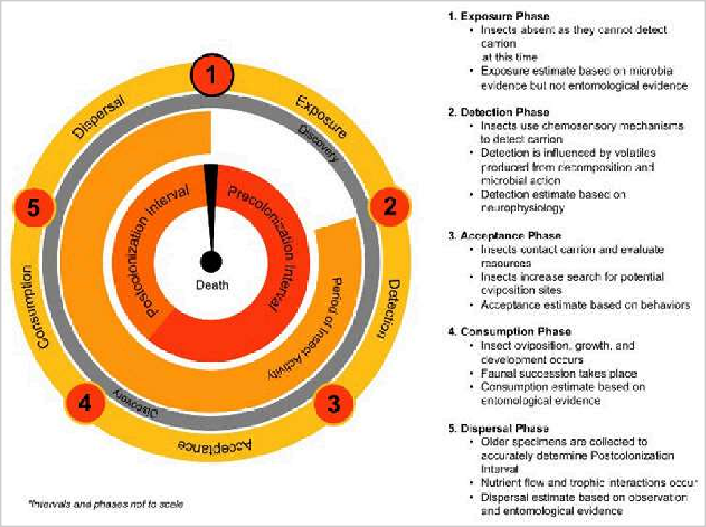
Insect SUCCESSION LEVEL ON CADAVER

Slide 18
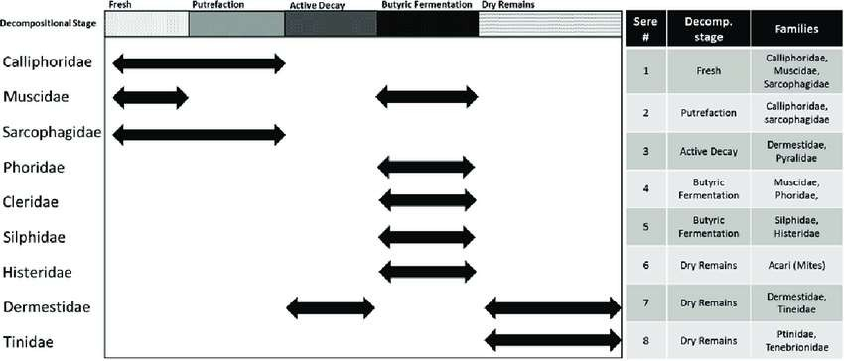

Slide 19
PMI Estimation
The postmortem interval (PMI) refers to the time that has elapsed since a person has died until the body is discovered or examined. Estimating the PMI is crucial in forensic investigations as it can help establish timelines, support or refute alibis, and provide insights into the circumstances surrounding a death.
Time of death and PMI cannot be determined with 100% accuracy particularly when a body is found in following condition:
Found in advanced decomposition stage
Recovered in water
Recovered in ice

Slide 20
Estimation of PMI
1. Algor mortis:
Algor mortis is the cooling of the body after death, primarily due to the loss of homeostatic regulation by the hypothalamus, in conjunction with the loss of heat to the environment by conduction, convection, and radiation. Algor mortis is the most accurate method of estimating TSD in the early post-mortem phase.
A rule of thumb states that there is a decrease of 1.5 degrees F every hour.

Slide 21
2. Rigor Mortis
Rigor mortis is the post-mortem stiffening of muscles caused by the depletion of adenosine triphosphate (ATP) from the muscles, which is necessary for the breakdown of actin-myosin filaments in the muscle fibers. Actin and myosin are components of the muscle fiber and form a bond during contraction. The cessation of oxygen supply causes the stoppage of aerobic respiration in the cells and leads to a lack of ATP production.
Rigor mortis appears approximately 2 hours after death in the muscles of the face, progresses to the limbs over the next few hours, completing between 6 to 8 hours after death. Rigor mortis then stays for another 12 hours (till 24 hours after death) and then disappears. Can last 36 hours in temperate climate.
In the last phase of rigor mortis, the actin-myosin complex that has formed starts disintegrating due to proteolysis, resulting in the dissolution of the stiffness.

Slide 22
3. Livor Mortis
The final change in the classical triad is livor mortis, which is the purplish-blue discoloration of the skin in the dependent parts of the body due to the collection of blood in skin vessels caused by gravitational pull. Hypostasis develops as spots of discoloration within half an hour to 2 hours. These spots then coalesce into larger patches, which combine to form a uniform discoloration of the body's dependant parts that have not been subject to pressure, which appears from 6 to 12 hours. The discoloration becomes 'fixed' after a certain period, owing to blood cells' disintegration and hemoglobin's seepage. This fixation is confirmed by applying pressure with thumbs and is traditionally used to denote a PMI greater than 12 hours.
4. Decomposition stages.

Slide 23
5. Forensic entomology:
Forensic entomology analysis has been a routine practice for estimating PMI in the early and late post-mortem periods. There are two methods of estimation using forensic entomology – based on succession and based on development. A suitable succession model is chosen for use in a succession-based approach, one that corresponds to the environmental conditions, including the circumstances of death. Therefore, forensic research into the effect of environmental factors on decomposition and insect succession is needed.
Blow fly and Flesh fly are generally the first to colonize.
Beetles are generally the next insect to colonize.
Hence, insect succession along with other factors helps in determining PMI

